Slide 1
Case Study : THE Chop House
Mahaveer awasthi
Chahatveer singh Gill
Gurdeep singh Dhaliwal
Harjot singh

Slide 2
THE Chop House
Chain Restaurant; 200+ Locations
Current Paper-based audit system
Time and money consuming process

Slide 3
Recommendations
Google Drive
Apple Ipad Pro
IBM DB2
HappyCo

Slide 4
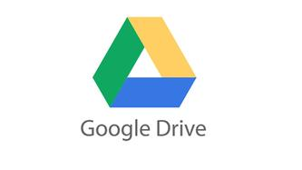
Google Drive
Cloud-Based service
Optical Character Recognition technology (Blast Magazine, 2012)
High level security
`
(Buckentin, 2015)

Slide 5
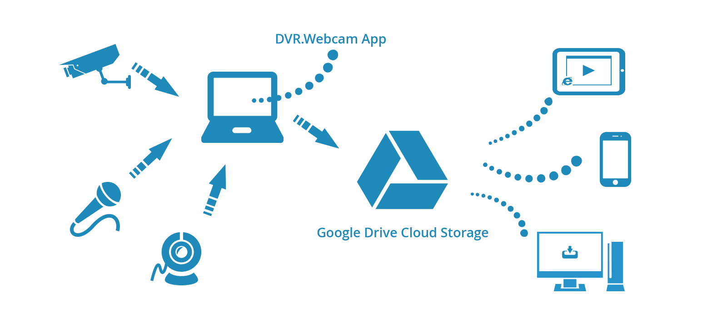
Google Drive
Easily accessible
3rd-party apps add-on feature
(DVR.Webcam, n.d.)

Slide 6
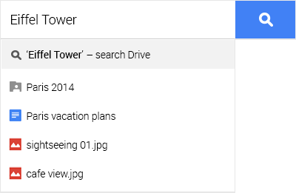
Google Drive
Offline Mode
Publish To Web (Inftrac, 2015)
Link Searching
(Google, n.d.)

Slide 7
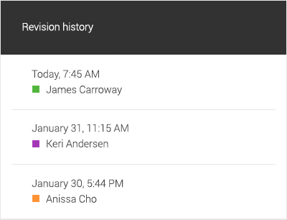
Google drive
Web Clipboard
Revision History (Desk, 2014)
Shortcuts
(Google, n.d.)

Slide 8
Google drive
Comments
Bookmarks
Mirror Image (Desk, 2014)

Slide 9
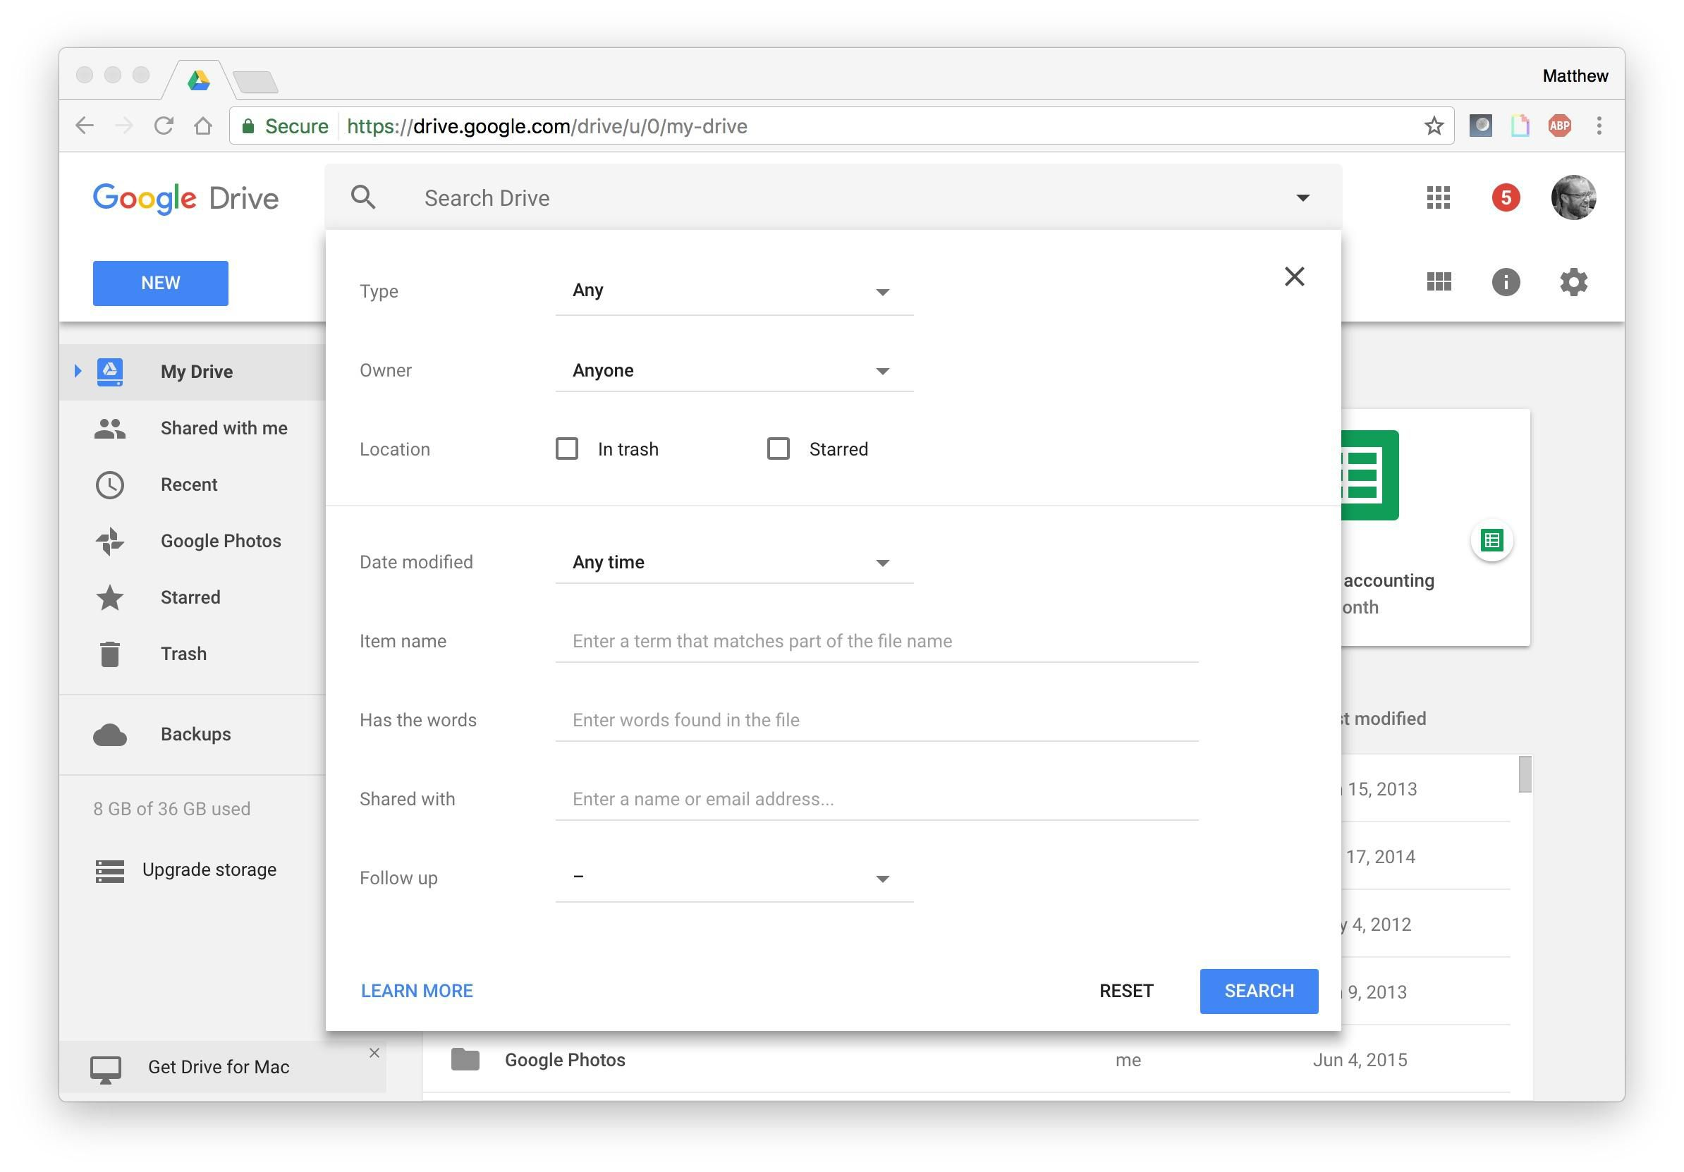
Google drive
Filter searches
(Elliot, 2017)

Slide 10
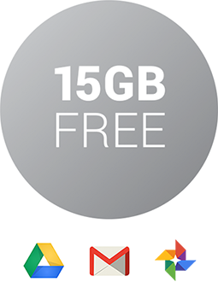
Google drive
One-tap phone backup (Elliot, 2017)
Cost
(Google, n.d.)

Slide 11
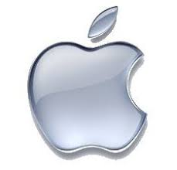
Apple Ipad Pro
12.9 Inches Screen
Smart Keyboard and Apple pencil feature(Web News Wire, 2015)
(UberGizmor, 2007)

Slide 12
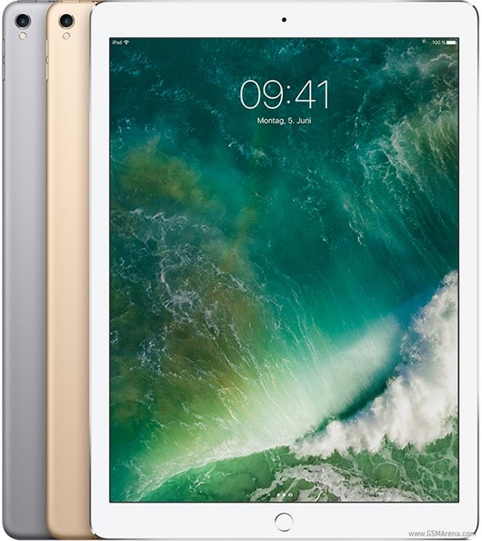
Apple Ipad Pro
Latest iOS 11.2.6(Shead, 2017)
Long Battery Life
File System Feature
(Gsmarena, 2017)

Slide 13
IBM DB2
Threat independent data structure
Keep the data enclosed and tightly packed

Slide 14

IBM DB2
Stores audit related data(IBM Knowledge, n.d.)
Excellent feature of auto-updating
Quick access to important information
(Geek, n.d.)

Slide 15

Happy Co Auditing Software
A new and fast growing company (Infotrac, 2018)
24/7 Customer Service
Mobile Applications (Wireless News, 2017)
(MRI Software, 2017)

Slide 16

Happy co inspector
Save time, save money
Upload all reports to the cloud
Use mobile devices(Wireless News, 2017)
HappyCo. (2012, January)

Slide 17

HAPPY CO Manage
View anywhere from the cloud
Manage specific or company wide reports
Improve location based on specific report
HappyCo. (2015, July)

Slide 18
Conclusion
Google Drive Online Access
Apple iPad Pro mobile platform
IBM Db2 Database Storage
HappyCo Inspector/Manage

Slide 19
References
Blast magazine: Google drive -- cloud storage becomes habit-forming. (2012) Chatham: Newstex. Retrieved February 18, 2018, from http://login.library.sheridanc.on.ca/login?url=https://search-proquest-com.library.sheridanc.on.ca/docview/1009596292?accountid=3455
Buckentin, J (October 26, 2015). “How to Set Up Google Drive Offline” Retrieved From https://sites.google.com/a/isd423.org/buckentin/tech-tips/howtosetupgoogledriveoffline
Desk, T. (2014, Aug 11). 10 cool new features in Google Drive. Financial Express.
Retrieved from http://login.library.sheridanc.on.ca/login?url=https://search-proquest-com.library.sheridanc.on.ca/docview/1552443646?accountid=3455
DVR.Webcam: Google Drive Edition. (n.d.).“How It Works” . Retrieved from, https://dvr.webcam/GoogleDrive/About

Slide 20
REFERENCES
Geek. (18th October 2016).“How-to: ODBC connection to DB2 instance” Retrieved from, https://geekanddummy.com/how-to-odbc-connection-to-db2-instance-e-g-mitel-csm/
Google Drive (n.d.) “your stuff, your way-drive features”. Retrieved From https://www.google.ca/drive/using-drive/
GSMArena, (2017) “Apple Ipad Pro 12.9 (2017)”. Retrieved from https://www.gsmarena.com/apple_ipad_pro_12_9_(2017)-8717.php
Happy Co. (2015, May). “Happy Inspector – Inspect Anything, Document Everything.” Retrieved from https://www.youtube.com/watch?v=2T_9pkEA5Bs
Elliot, M (June 16, 2017) “7hidden features of google drive” CNET. Retrieved From https://www.cnet.com/how-to/hidden-features-of-google-drive/

Slide 21
References
Infotrac Newsstand (April 12, 2015)"5 Undiscovered Features Of Google Drive." EFYtimes.com, Retrieved from http://link.galegroup.com.library.sheridanc.on.ca/apps/doc/A409363033/STND?u=ko_acd_shc&sid=STND&xid=40a33ea5. Accessed 11 Mar. 2018.
“IBM Knowledge Center” (Erin McKean, Developer Advocate, IBM),n.d. Retrieved From https://www.ibm.com/support/knowledgecenter/en/...10...ibm.db2.../r0053238.html
Infotrac Newsstand. (2018, January) "HappyCo Expands Executive Team, Crosses One Million Units Mark." Marketing Weekly News p. 33. Retrieved March 12, 2018, from http://go.galegroup.com.library.sheridanc.on.ca/ps/i.do?p=STND&u=ko_acd_shc&id=GALE|A524004833&v=2.1&it=r&sid=summon&authCount=1
MRI Software. (June 21, 2017) “MRI Software and HappyCo Partner to Launch MRI Inspections”. Retrieved From https://www.prnewswire.com/news-releases/mri-software-and-happyco-partner-to-launch-mri-inspections-300477198.html

Slide 22
References
Shead, S. (2017, September 19). Apple has released its huge new iOS 11 software update for iPhone and iPad. Retrieved from http://www.businessinsider.com/apple-releases-ios-11-software-update-iphone-ipad-2017-9
UberGizmor. (2007, December). “Apple and Fox Sign a Deal”. Retrieved from http://www.ubergizmo.com/2007/12/apple-fox-sign-deal/
Web News Wire. (2016, June). "Apple Introduces iPad Pro Featuring Epic 12.9-inch Retina Display” Infotrac Newsstand Retrieved from http://go.galegroup.com.library.sheridanc.on.ca/ps/i.do?p=STND&u=ko_acd_shc&id=GALE|A456416162&v=2.1&it=r&sid=STND&asid=53b1fb4f#
Wireless News. (2017, May) “HappyCo Introduces Happy API.”. Retrieved March 12, 2018, from https://search-proquest-com.library.sheridanc.on.ca/docview/1895946171?pq-origsite=summon

Slide 23
References
HappyCo. (2012, January) “HappyCo Inspector”. Retrieved From https://happyco.com/solutions/happy-inspector/
HappyCo. (2015, July) “HappyCo Inspector”. Retrieved From https://happyco.com/solutions/happy-inspector/

Slide 24
References

Slide 25
References

Slide 26
References

